Slide 1
Cloud Pak for Data: Administration

Slide 2
Administration:
Administering the Cluster
Administering the Web Client
Notes:
When clients start with IBM Cloud Private for Data, they get the foundational capabilities for the COLLECT, ORGANIZE and ANALYZE rungs on the AI Ladder, all integrated via the flexibility of cloud-native microservices. They can access data, create policy-based catalogs, build open source AI/ML models, visualize data with dashboards, and more. You can think of these capabilities as cloud-native microservice versions of our core offerings (like Db2, InfoSphere, DataStage, Watson Studio, and Cognos Analytics), integrated into a platform. No assembly required.

Slide 3
Administering the Cluster:
Scaling Services
Adding nodes to your cluster
Backing up and migrating product metadata
Notes:
When clients start with IBM Cloud Private for Data, they get the foundational capabilities for the COLLECT, ORGANIZE and ANALYZE rungs on the AI Ladder, all integrated via the flexibility of cloud-native microservices. They can access data, create policy-based catalogs, build open source AI/ML models, visualize data with dashboards, and more. You can think of these capabilities as cloud-native microservice versions of our core offerings (like Db2, InfoSphere, DataStage, Watson Studio, and Cognos Analytics), integrated into a platform. No assembly required.

Slide 4
Administering the Web Client:
Manage Users
Manage Platform
Configure Platform
Gather Diagnostics
Notes:
When clients start with IBM Cloud Private for Data, they get the foundational capabilities for the COLLECT, ORGANIZE and ANALYZE rungs on the AI Ladder, all integrated via the flexibility of cloud-native microservices. They can access data, create policy-based catalogs, build open source AI/ML models, visualize data with dashboards, and more. You can think of these capabilities as cloud-native microservice versions of our core offerings (like Db2, InfoSphere, DataStage, Watson Studio, and Cognos Analytics), integrated into a platform. No assembly required.

Slide 5
Cloud Pak for Data: add-on services - integrated & managed by one control plane

Slide 6
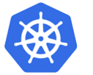

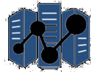
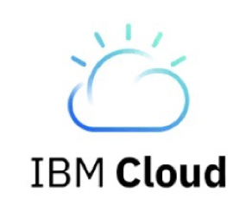
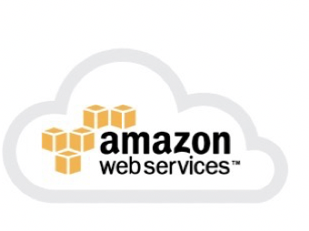
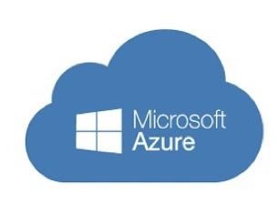

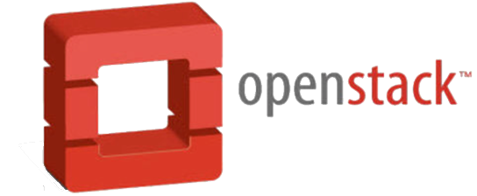
The CPD Control Plane (“Bedrock”) enables a layered approach and plug-n-play
A consistency in delivery, Deployments & management
Cloud Pak for Data
Control Plane
Authentication, Roles and Authorization
Installation & Patching. & upgrades
Extensibility – Add-on Services & Access management
Workloads Management | Metering | Diagnostics
Backup & Restore
Notes:
When clients start with IBM Cloud Private for Data, they get the foundational capabilities for the COLLECT, ORGANIZE and ANALYZE rungs on the AI Ladder, all integrated via the flexibility of cloud-native microservices. They can access data, create policy-based catalogs, build open source AI/ML models, visualize data with dashboards, and more. You can think of these capabilities as cloud-native microservice versions of our core offerings (like Db2, InfoSphere, DataStage, Watson Studio, and Cognos Analytics), integrated into a platform. No assembly required.

Slide 7

Plug-n-play with add-on services
example: Governed Data Science Pattern
Watson Studio
Watson ML
Watson Knowledge Catalog
Common Services
[dependencies]
Projects
Collaborations
Notifications
Connections
Refinery
Cloud Pak for Data
Control Plane
Notes:
When clients start with IBM Cloud Private for Data, they get the foundational capabilities for the COLLECT, ORGANIZE and ANALYZE rungs on the AI Ladder, all integrated via the flexibility of cloud-native microservices. They can access data, create policy-based catalogs, build open source AI/ML models, visualize data with dashboards, and more. You can think of these capabilities as cloud-native microservice versions of our core offerings (like Db2, InfoSphere, DataStage, Watson Studio, and Cognos Analytics), integrated into a platform. No assembly required.

Slide 8
Plug-n-play with add-on services
deploy in whatever order you need to
and scale out
Watson Studio
Watson ML
Watson Knowledge Catalog
Common Services
[dependencies]
Projects
Collaborations
Notifications
Connections
Refinery
Cloud Pak for Data
Control Plane
Notes:
When clients start with IBM Cloud Private for Data, they get the foundational capabilities for the COLLECT, ORGANIZE and ANALYZE rungs on the AI Ladder, all integrated via the flexibility of cloud-native microservices. They can access data, create policy-based catalogs, build open source AI/ML models, visualize data with dashboards, and more. You can think of these capabilities as cloud-native microservice versions of our core offerings (like Db2, InfoSphere, DataStage, Watson Studio, and Cognos Analytics), integrated into a platform. No assembly required.

Slide 9
Plug-n-play with add-on services
example: Operationalize ML Pattern
Watson ML
Watson OpenScale
Common Services
[dependencis]
Projects
Collaborations
Notifications
Connections
Db2WH ( WOS dependencies )
Cloud Pak for Data
Control Plane
Notes:
When clients start with IBM Cloud Private for Data, they get the foundational capabilities for the COLLECT, ORGANIZE and ANALYZE rungs on the AI Ladder, all integrated via the flexibility of cloud-native microservices. They can access data, create policy-based catalogs, build open source AI/ML models, visualize data with dashboards, and more. You can think of these capabilities as cloud-native microservice versions of our core offerings (like Db2, InfoSphere, DataStage, Watson Studio, and Cognos Analytics), integrated into a platform. No assembly required.

Slide 10

Plug-n-play with add-on services
example: Data Virtualization
Data Virtualization
Cloud Pak for Data
Control Plane
Notes:
When clients start with IBM Cloud Private for Data, they get the foundational capabilities for the COLLECT, ORGANIZE and ANALYZE rungs on the AI Ladder, all integrated via the flexibility of cloud-native microservices. They can access data, create policy-based catalogs, build open source AI/ML models, visualize data with dashboards, and more. You can think of these capabilities as cloud-native microservice versions of our core offerings (like Db2, InfoSphere, DataStage, Watson Studio, and Cognos Analytics), integrated into a platform. No assembly required.

Slide 11
Plug-n-play with add-on services
example: Governed Data Access Plane Pattern
Data Virtualization
Watson Knowledge Catalog
Common Services
[dependencies]
Projects
Collaborations
Notifications
Connections
Refinery
Cloud Pak for Data
Control Plane
Notes:
When clients start with IBM Cloud Private for Data, they get the foundational capabilities for the COLLECT, ORGANIZE and ANALYZE rungs on the AI Ladder, all integrated via the flexibility of cloud-native microservices. They can access data, create policy-based catalogs, build open source AI/ML models, visualize data with dashboards, and more. You can think of these capabilities as cloud-native microservice versions of our core offerings (like Db2, InfoSphere, DataStage, Watson Studio, and Cognos Analytics), integrated into a platform. No assembly required.

Slide 12
The control plane facilitates “standalone” Services
such as Data Stage
Data Stage
Cloud Pak for Data
Control Plane
Notes:
When clients start with IBM Cloud Private for Data, they get the foundational capabilities for the COLLECT, ORGANIZE and ANALYZE rungs on the AI Ladder, all integrated via the flexibility of cloud-native microservices. They can access data, create policy-based catalogs, build open source AI/ML models, visualize data with dashboards, and more. You can think of these capabilities as cloud-native microservice versions of our core offerings (like Db2, InfoSphere, DataStage, Watson Studio, and Cognos Analytics), integrated into a platform. No assembly required.

Slide 13
The control plane facilitates “standalone” Services
and Watson AI services
Watson Assistant
Watson Discovery
Cloud Pak for Data
Control Plane
Notes:
When clients start with IBM Cloud Private for Data, they get the foundational capabilities for the COLLECT, ORGANIZE and ANALYZE rungs on the AI Ladder, all integrated via the flexibility of cloud-native microservices. They can access data, create policy-based catalogs, build open source AI/ML models, visualize data with dashboards, and more. You can think of these capabilities as cloud-native microservice versions of our core offerings (like Db2, InfoSphere, DataStage, Watson Studio, and Cognos Analytics), integrated into a platform. No assembly required.

Slide 14
